Slide 1
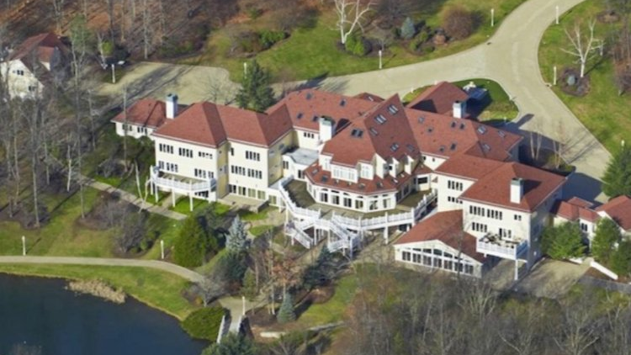
Housing Linear Regression
By: Wyatt Carter
Zach Duff

Slide 2
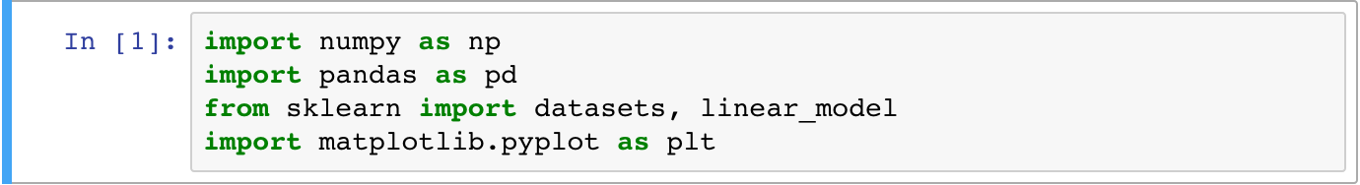
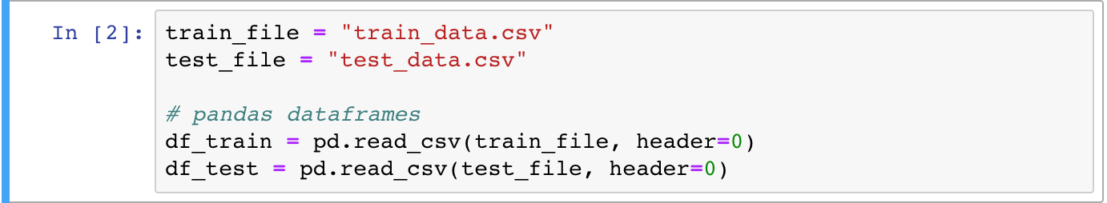
Data Preparation
First thing we need to do is get Python to read our data
Using pandas to grab the data from the cvs files and place them into the pandas dataframes

Slide 3
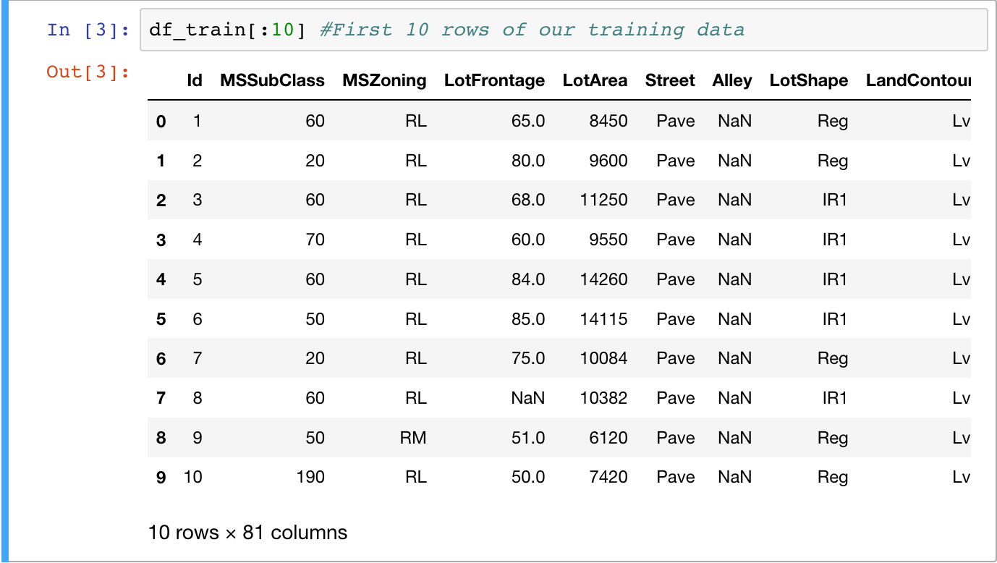
Data Preparation
An example of a pandas dataframe structure

Slide 4
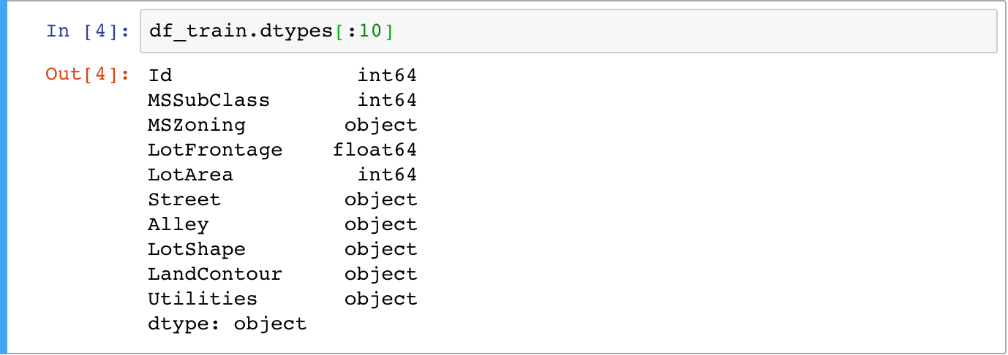
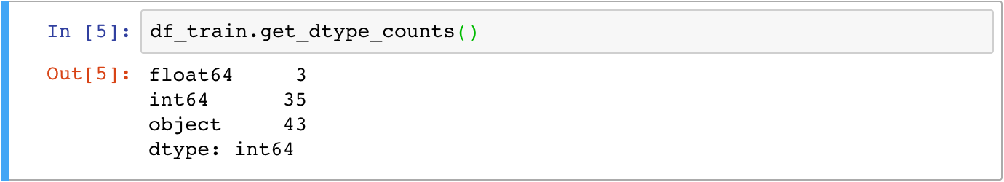
Data Preparation
Displaying datatypes will help split the data into quantitative and categorical parameters

Slide 5
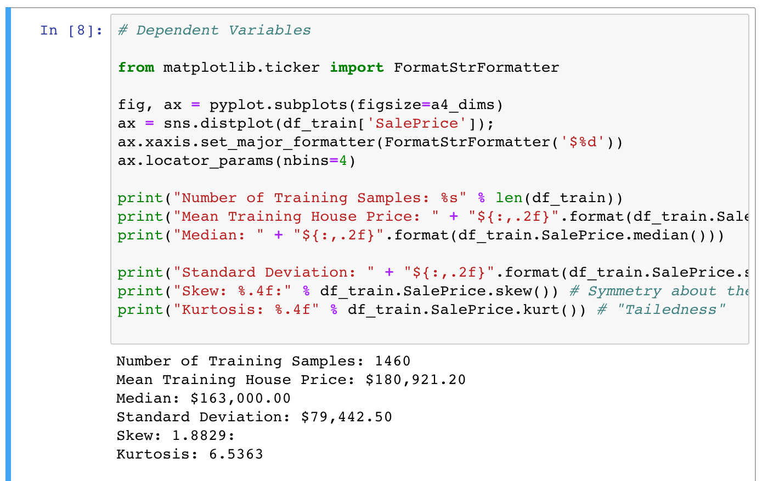
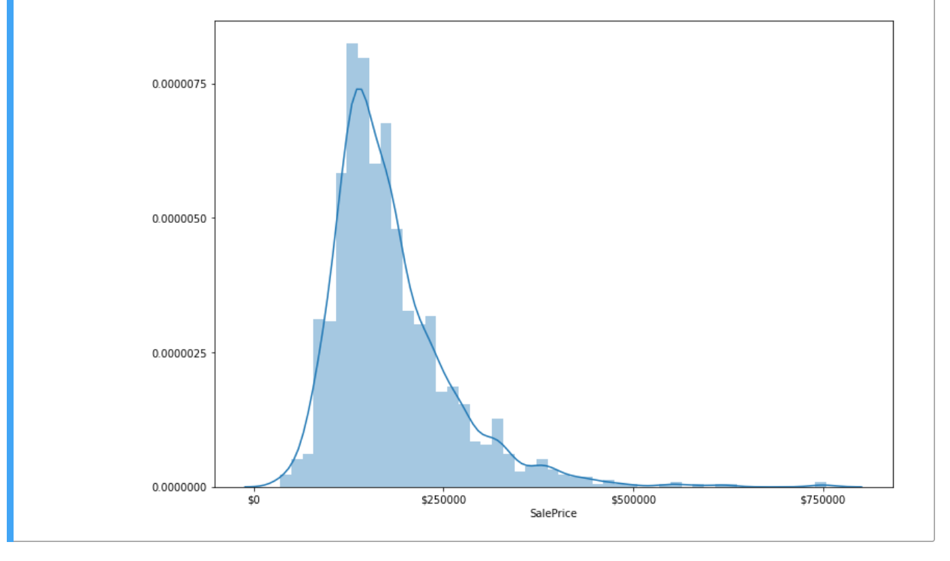
A Quick Look at the Target Variable
Our main objective is predicting housing price
Mean, median, standard deviation, skew and kurtosis give an insight into how Sale Price is distributed
The density curve shows actual distribution

Slide 6
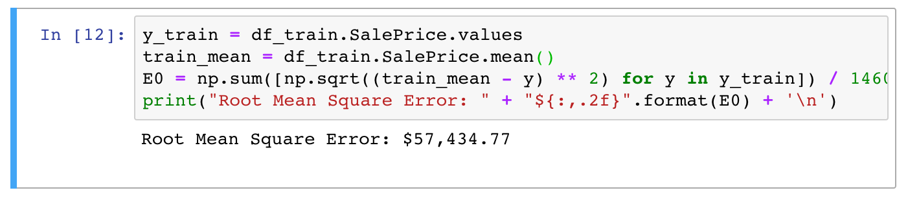

A Quick Look at Target Variable
Using Mean Absolute Error Function:
$E_{0}=\frac{1}{1460}\sqrt{\sum_{i=0}^{1459}{{\left(y^{i}−\overline{y}\right)}^{2}}}$

Slide 7
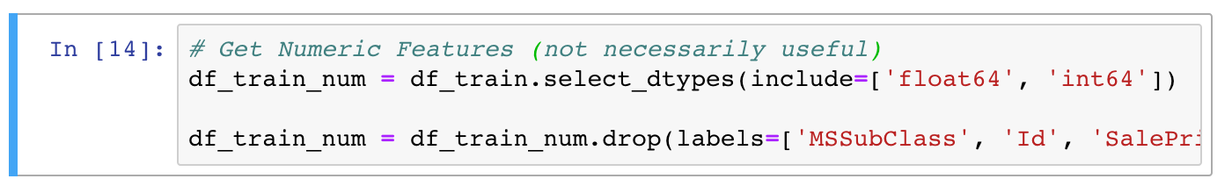
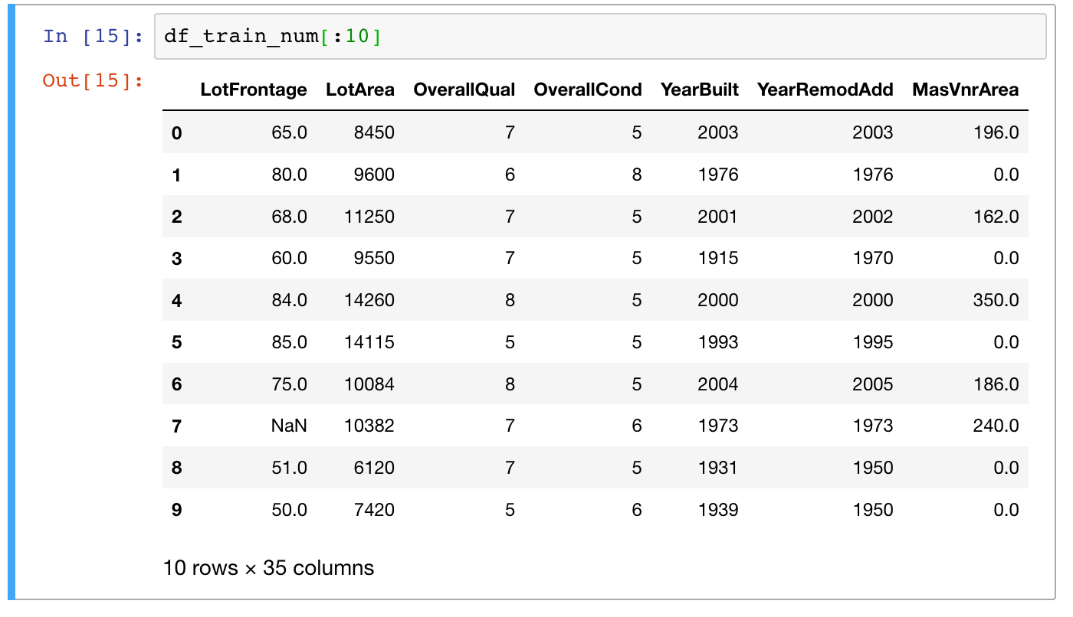
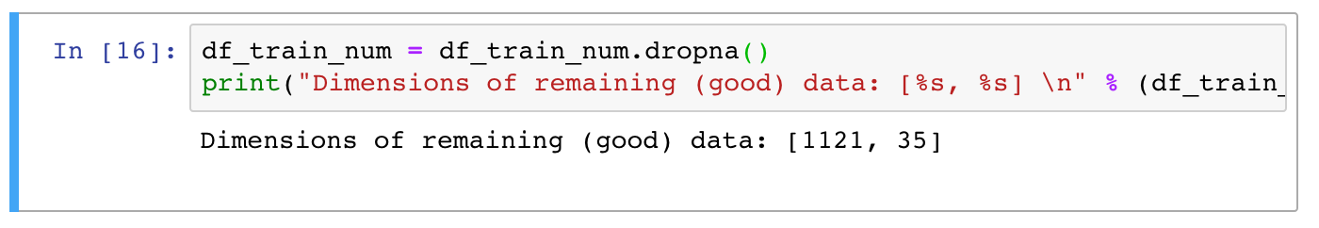
Data Cleaning
With over 80 parameters there is an overabundance of parameters
Because of this we can focus on only the quantitative parameters
We achieve this by only including ‘float64’ and ‘int64’
Also removed any subjects with NaN values

Slide 8
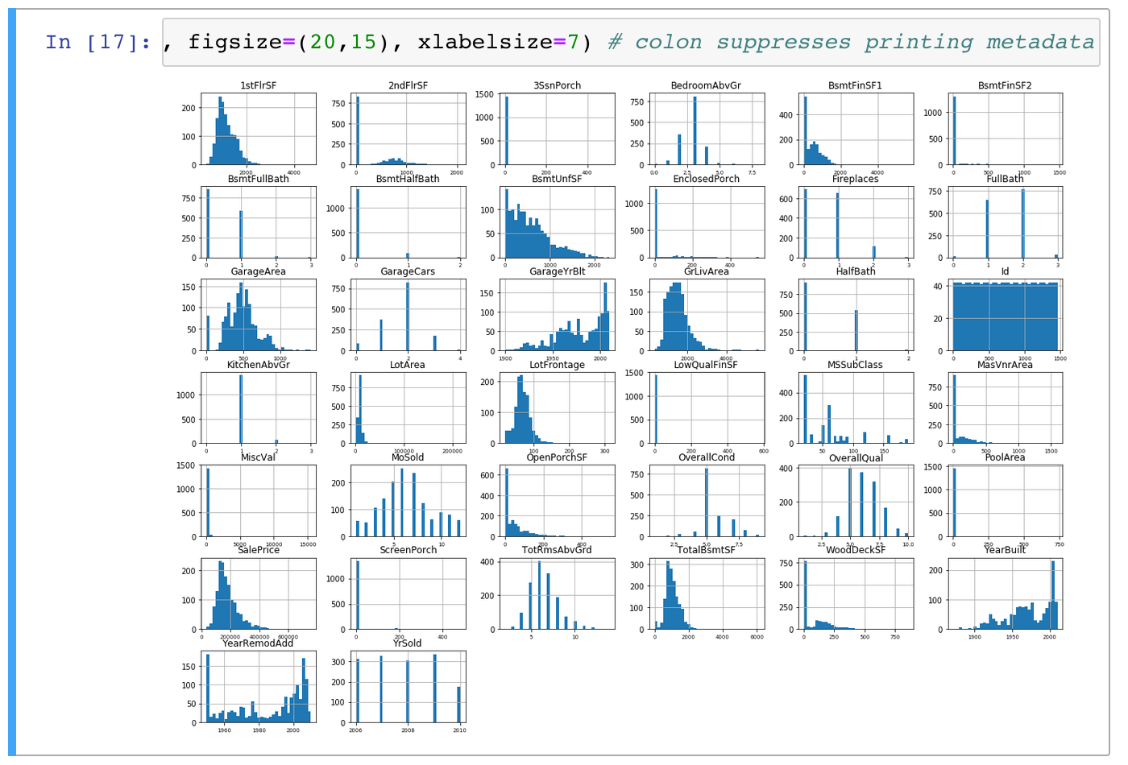
Data Exploration
After removals, our reduced model has 35 parameters
Here are the histograms of each parameter, showing distribution

Slide 9
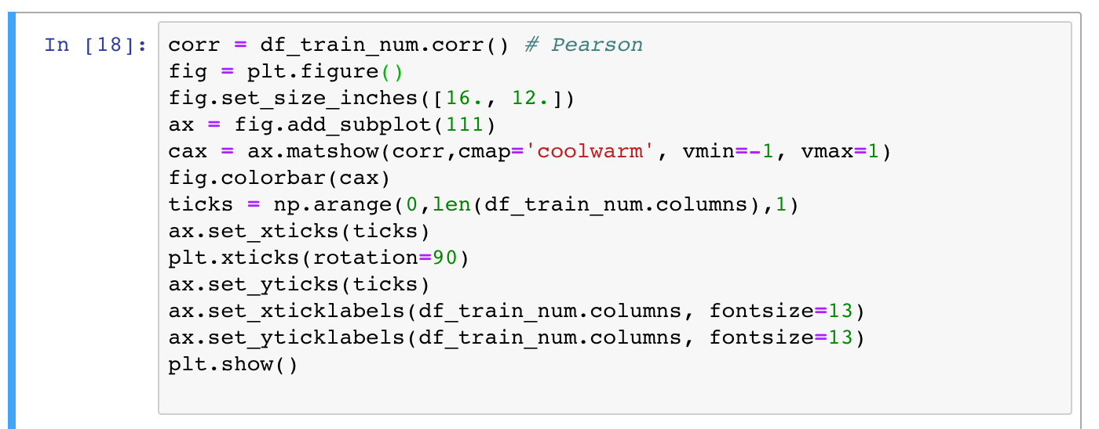
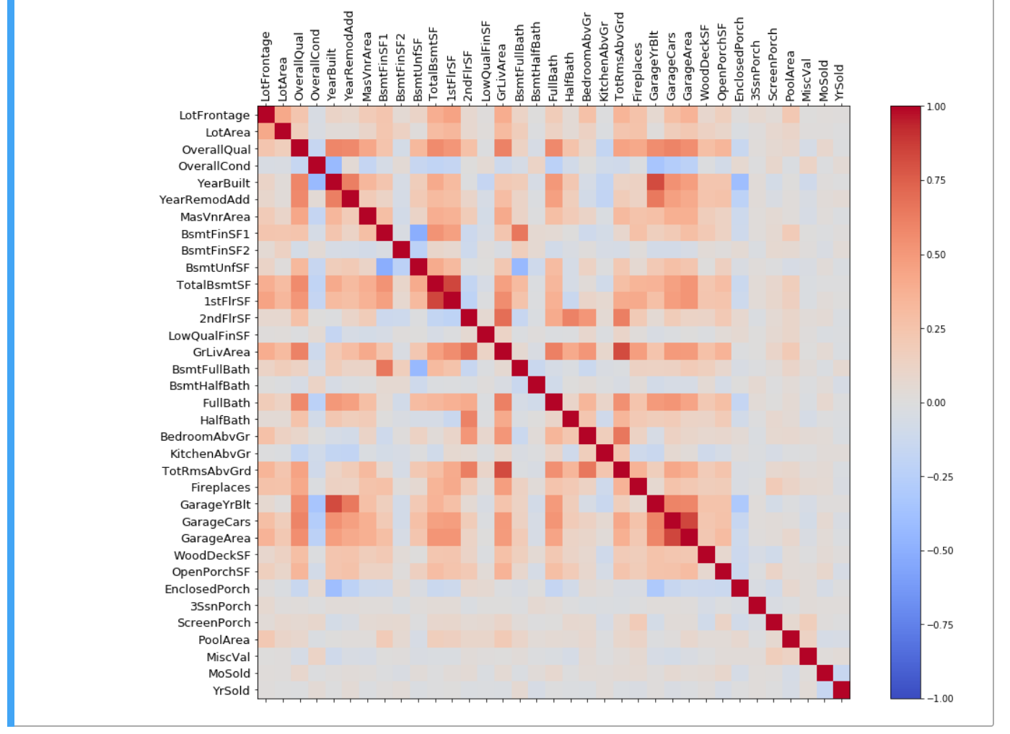
Data Exploration
Now, we take a look at the correlation between each parameter
Correlation allows us to see which parameters are redundant and save us from overparameterizing the model
Symmetric matrix with 1’s across the diameter is expected

Slide 10
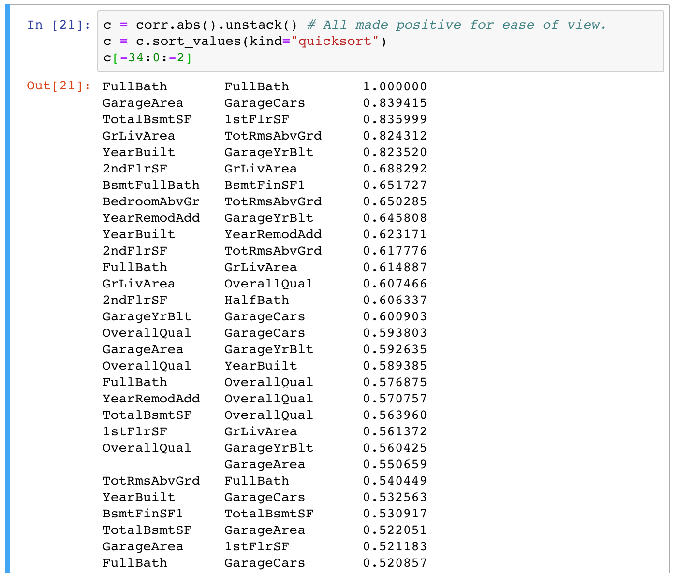
Data Exploration
Taking a closer look correlation
A high correlation shows pairs that would cause the model to be over parameterized

Slide 11
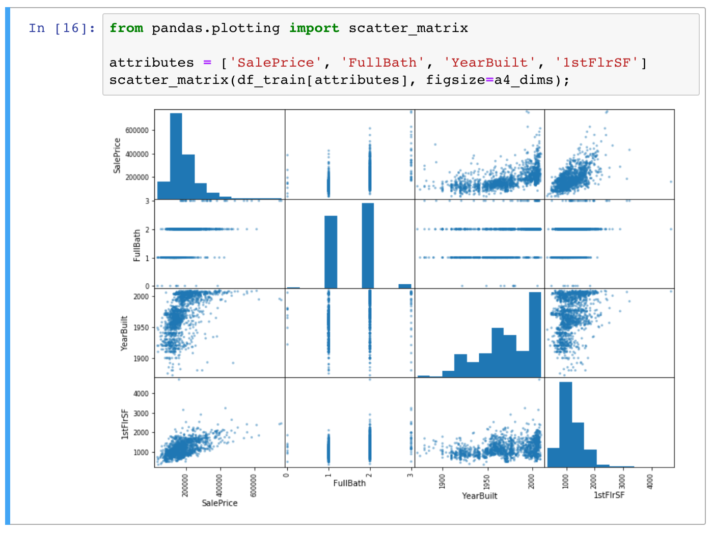
Data Exploration
Taking a few parameters and plotting them with respect to each other and SalePrice

Slide 12
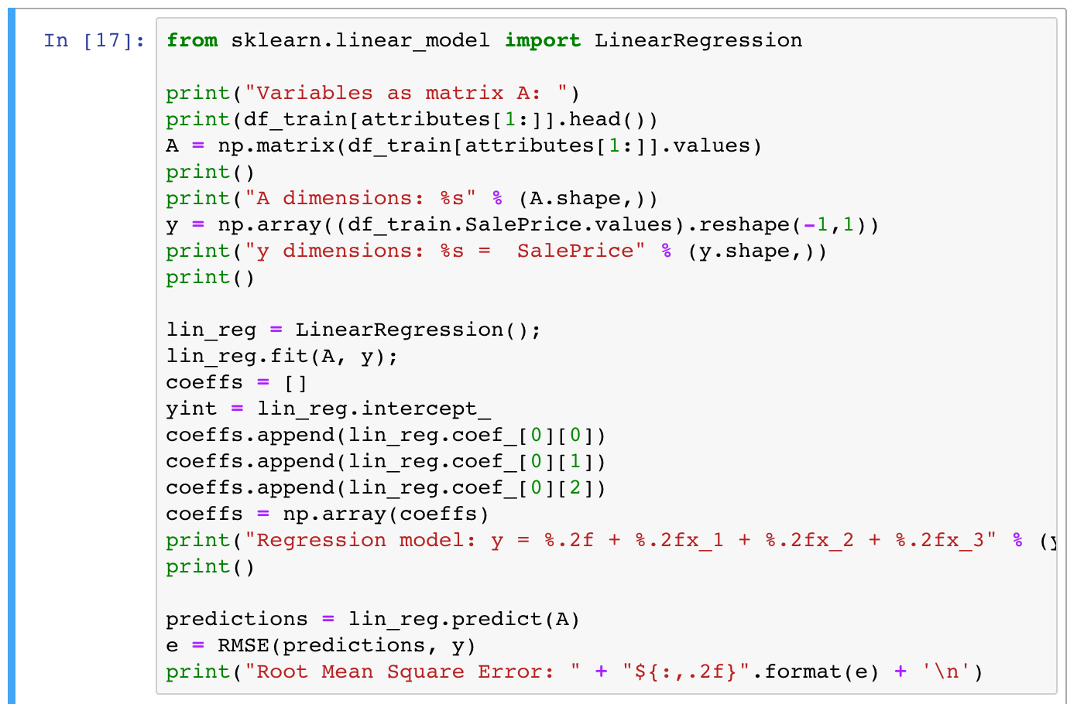
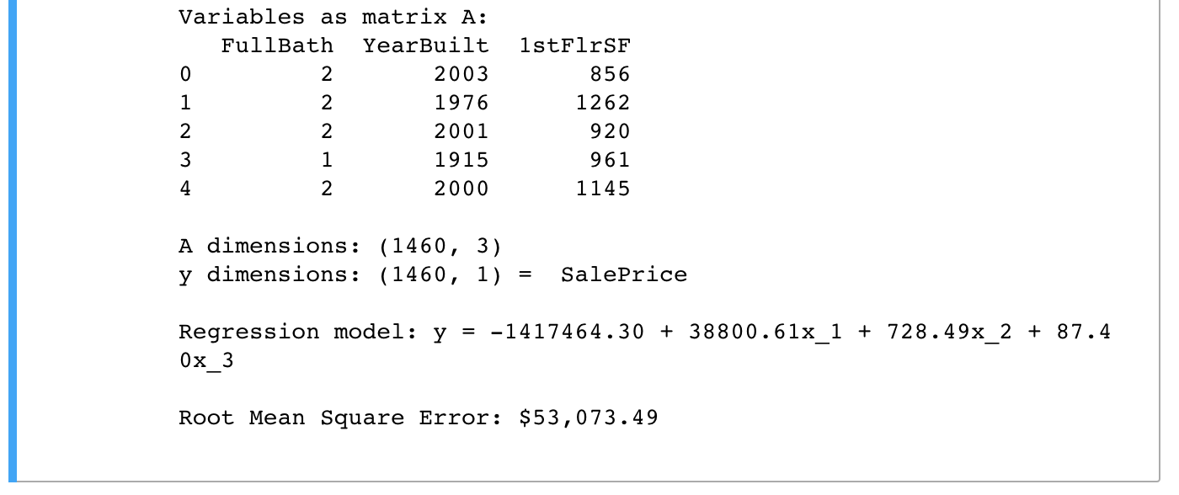
First Shot at Regression
Now that we’ve analyzed our data and removed parameters that don’t help us, we put together our first regression
We choose random parameters based on the correlation map
This reduced our Root Mean Square Error to $53,073.49

Slide 13
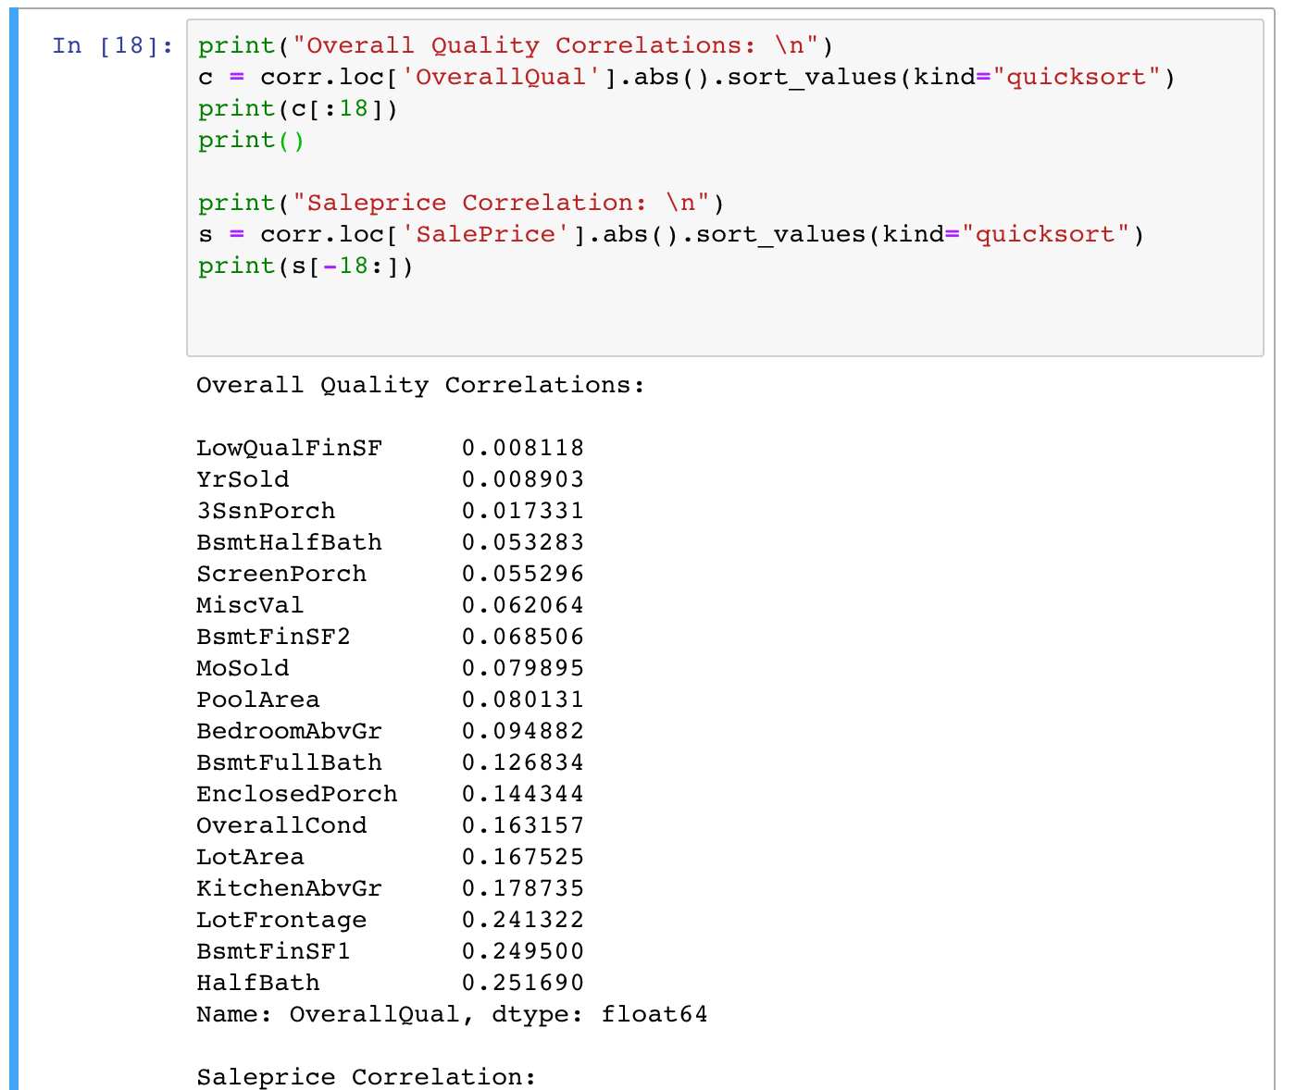
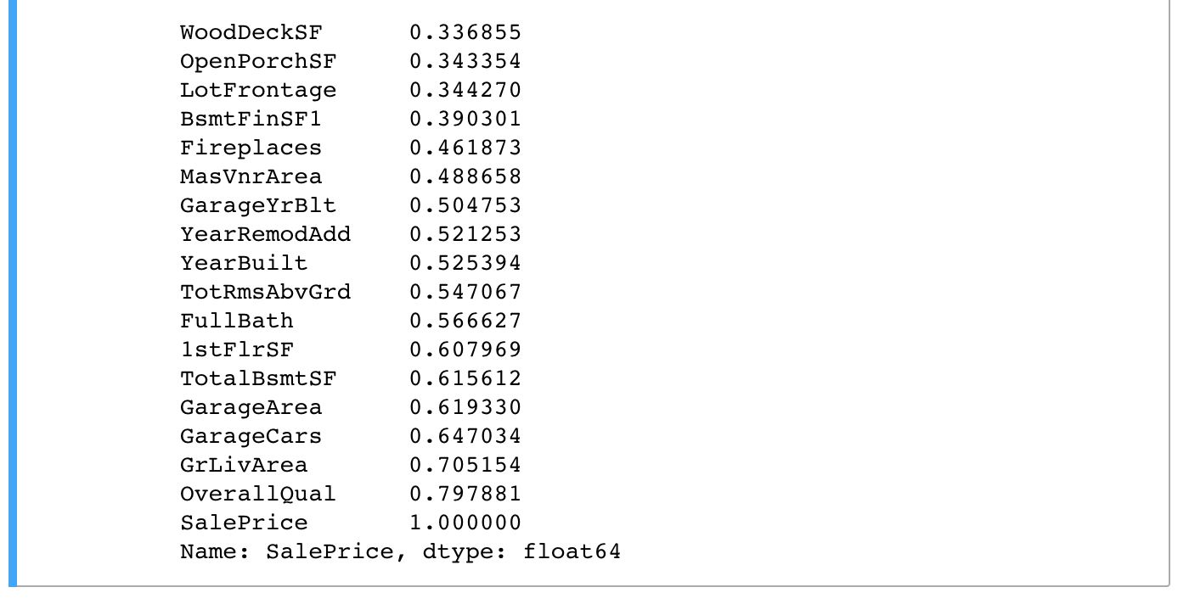
Greedy Alteration
Looking back at the heat map, we notice OverallQual is strongly correlated with SalePrice
Checking the correlation of OverallQual with other parameters to choose other parameters in our model

Slide 14
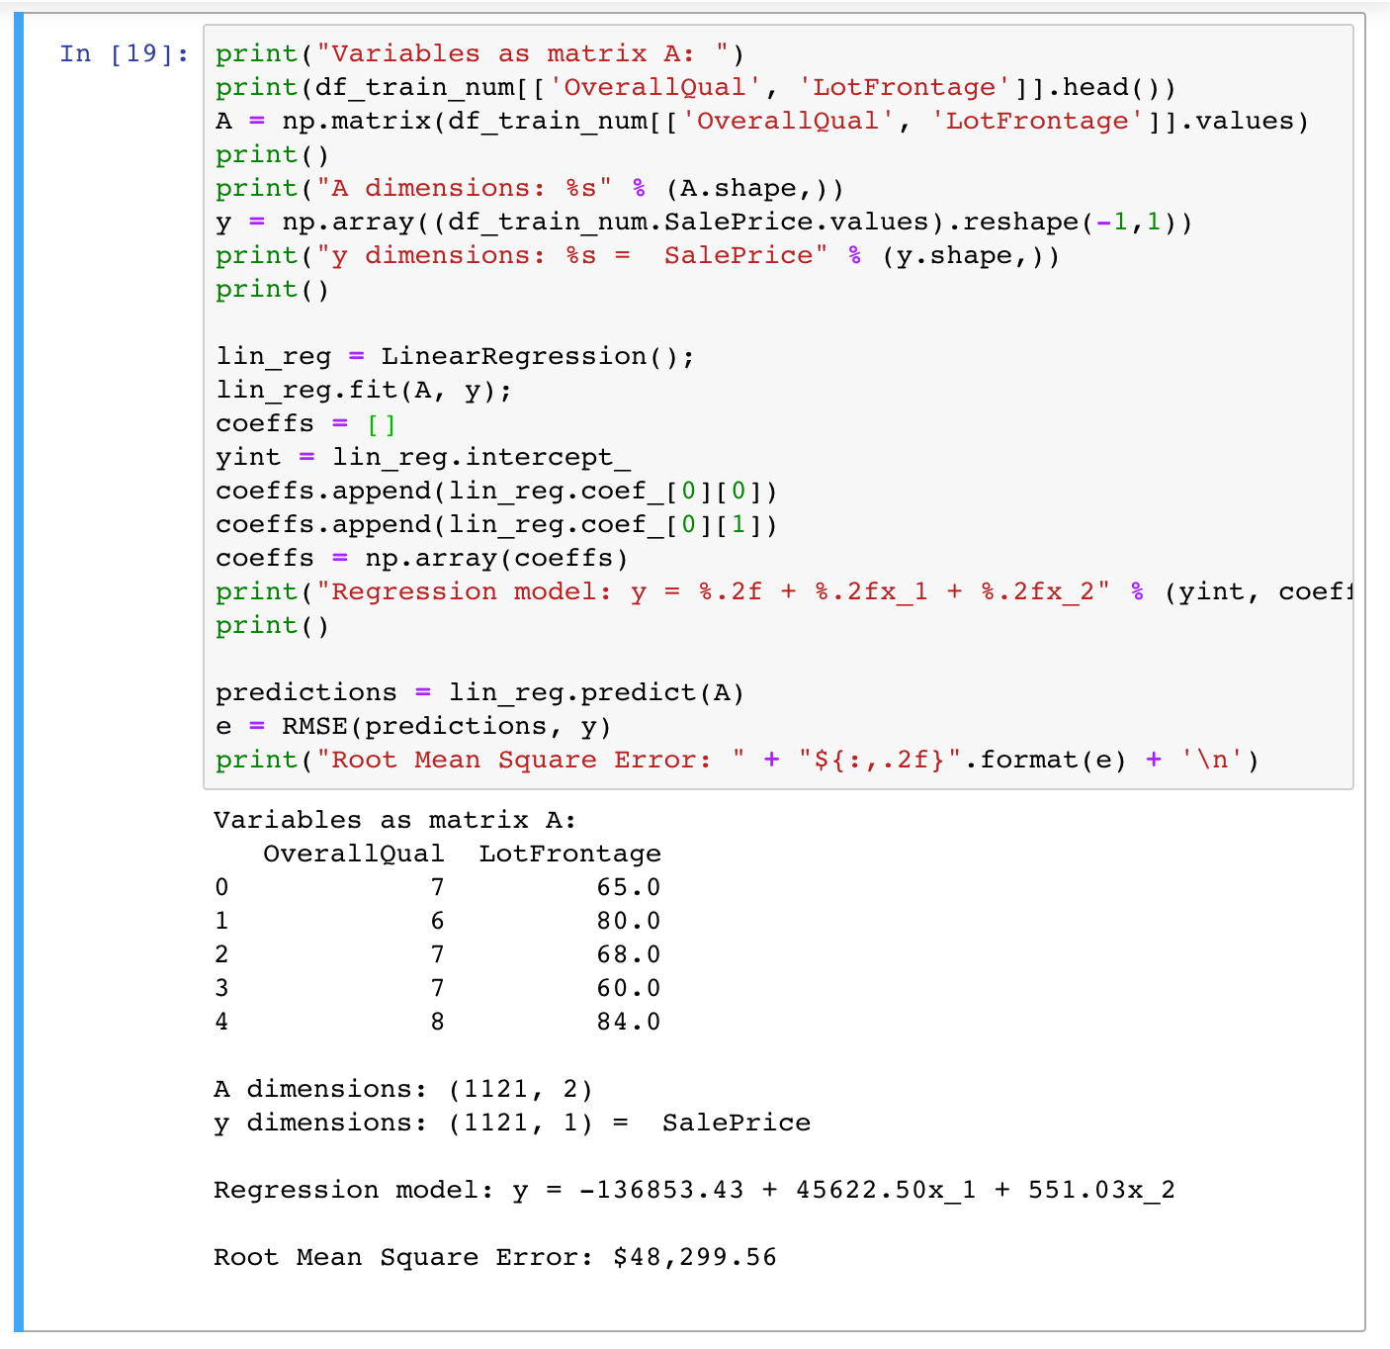
Greedy Alteration
Now building out new model using OveralQual and LotFrontage
Reduces our RMSE to $48,299.56
One more manual selection

Slide 15
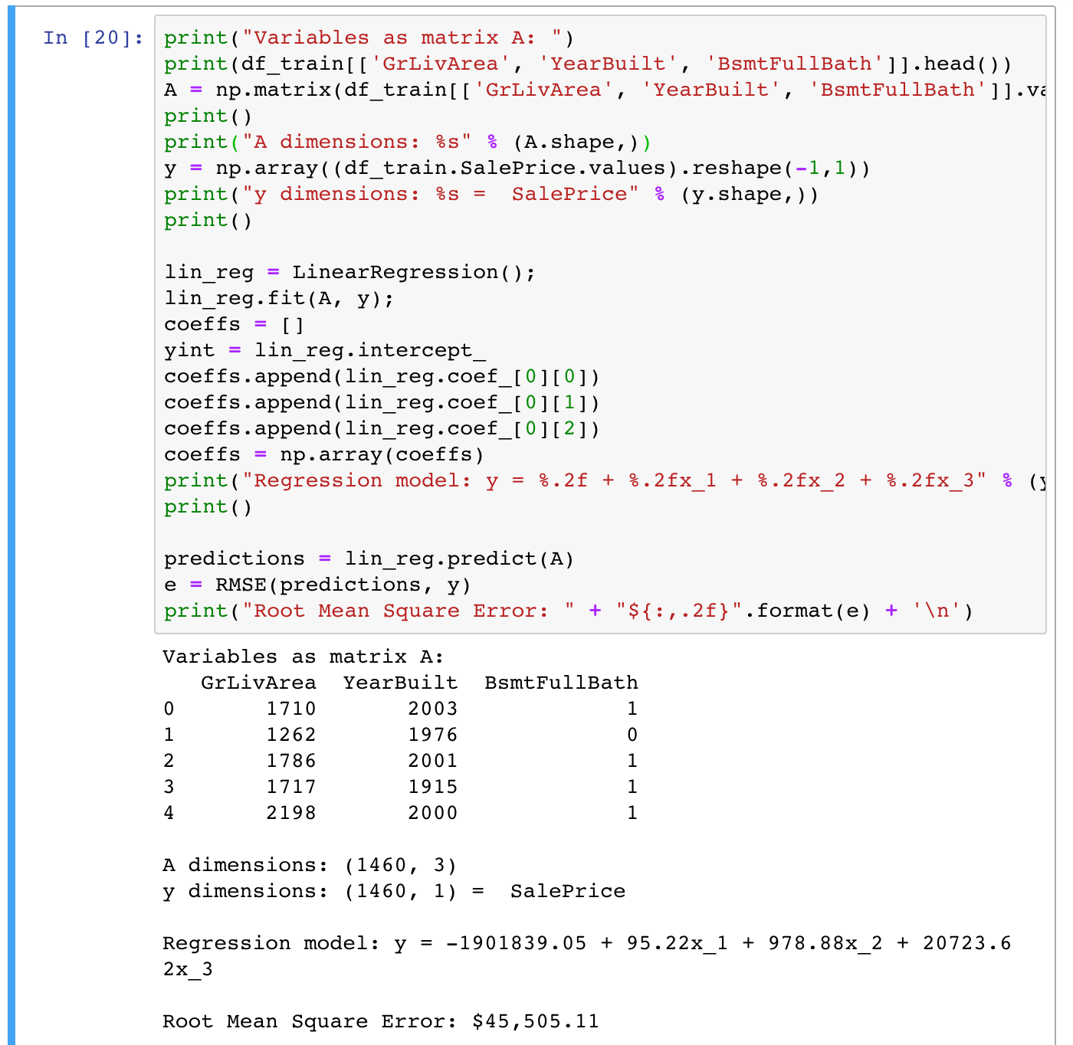
Greedy Alteration
Selecting GrLivArea, YearBuilt and BsmtFullBath
Reduces our RMSE to $45,505.11
Now onto smarter selection methods

Slide 16
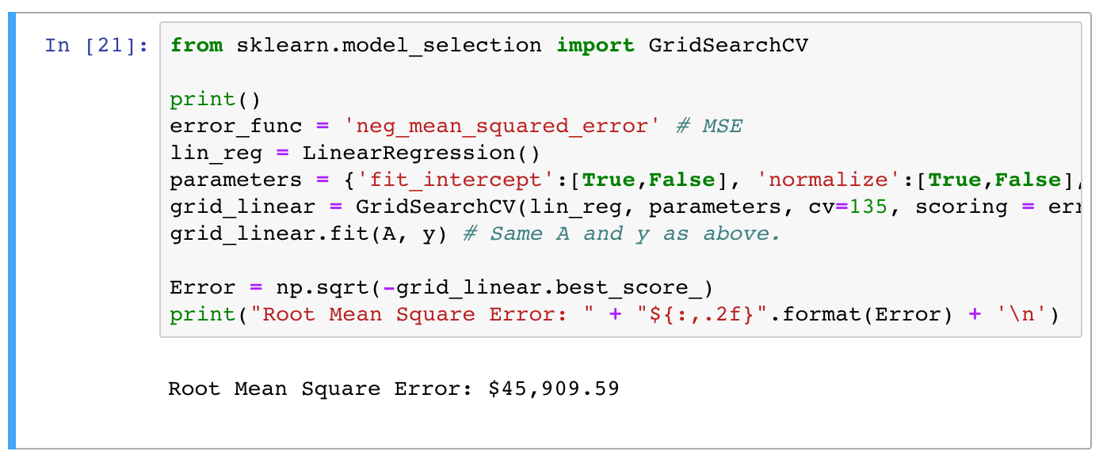
Smarter Model = Gridsearch
Now we’ll use the Normal equation to find the best coefficients in a streamlined manner
GridSearchCV() is described as ‘Exhaustive search over specified parameter values for an estimator
First, we’ll check our previous answers to verify our previous implementations
For some reason GridSearchCV() lost performed worse than previous models

Slide 17
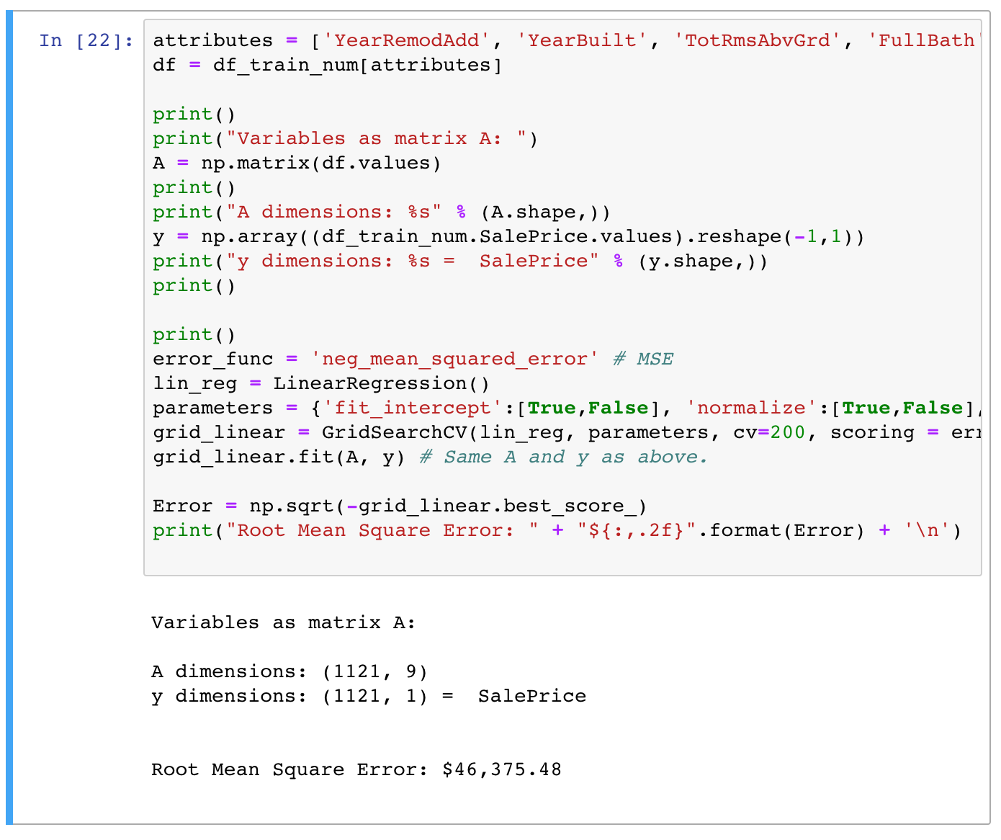
Smarter Method = Gridsearch
Even though our previous model had a worse RMSE using GridSearchCV(), it still performs all the heavy lifting compared to LinearRegression()
Now we choose the top 5 features correlated with SalePrice
Still did not beat our manual picked method
Let’s try with fewer features

Slide 18
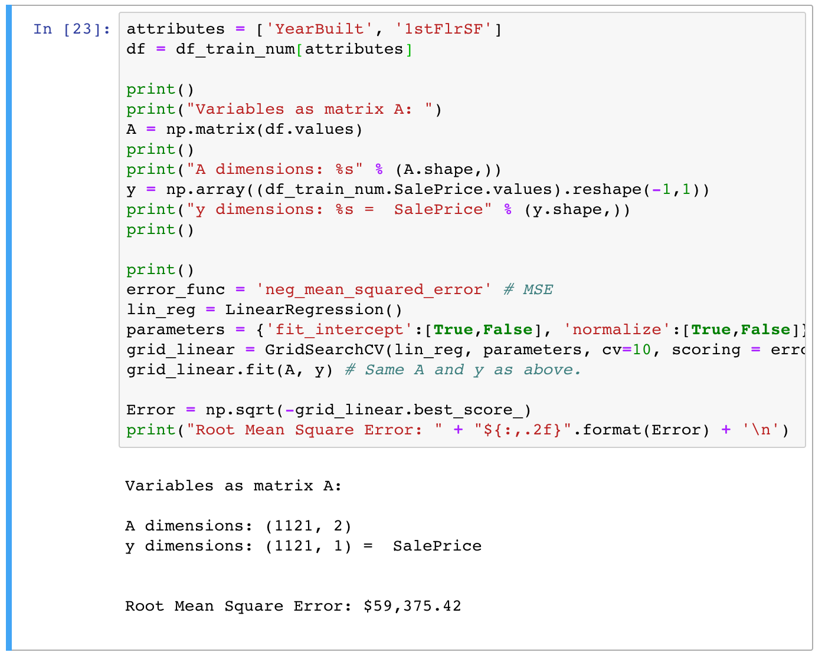
Smarter Method = Gridsearch
Just using YearBuilt and 1stFlrSF
RMSE = $59,375.42

Slide 19
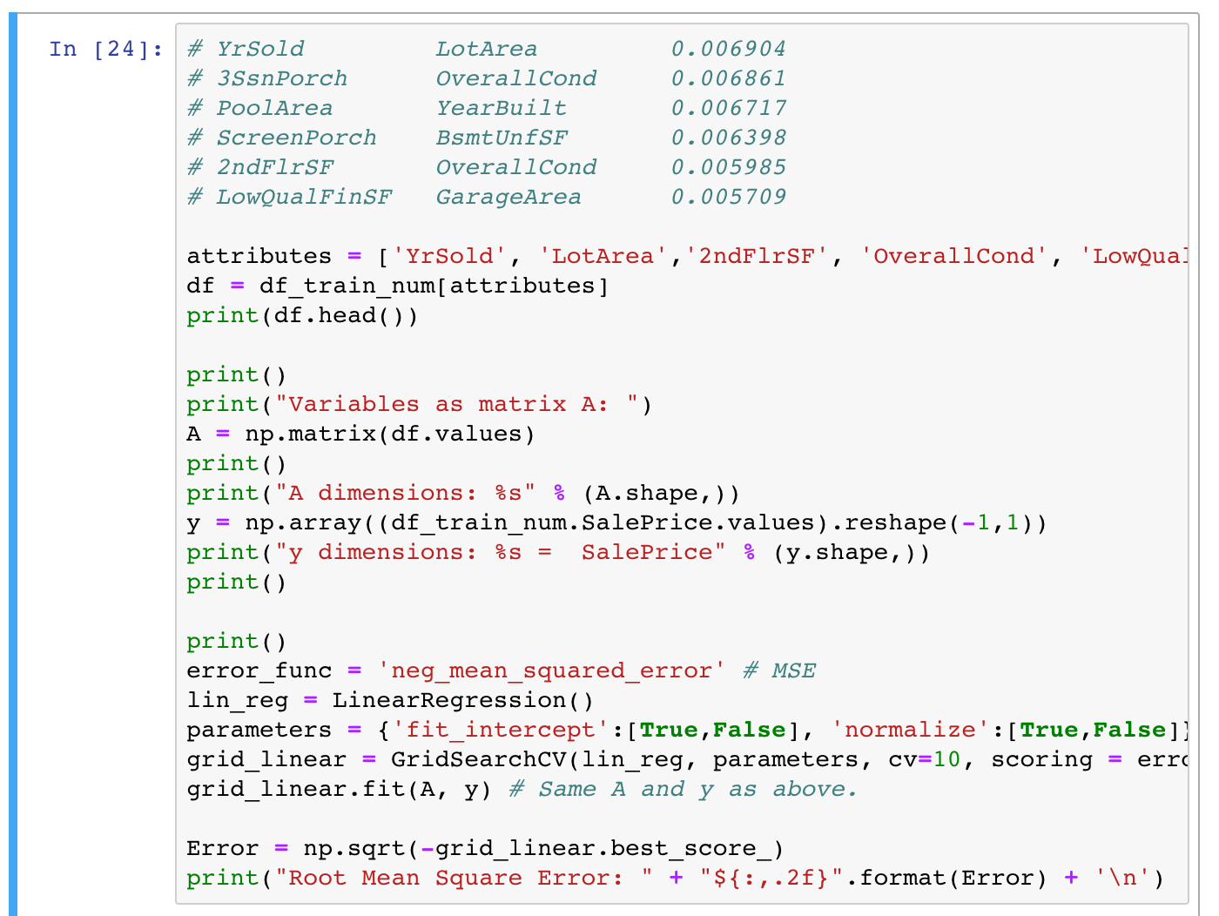
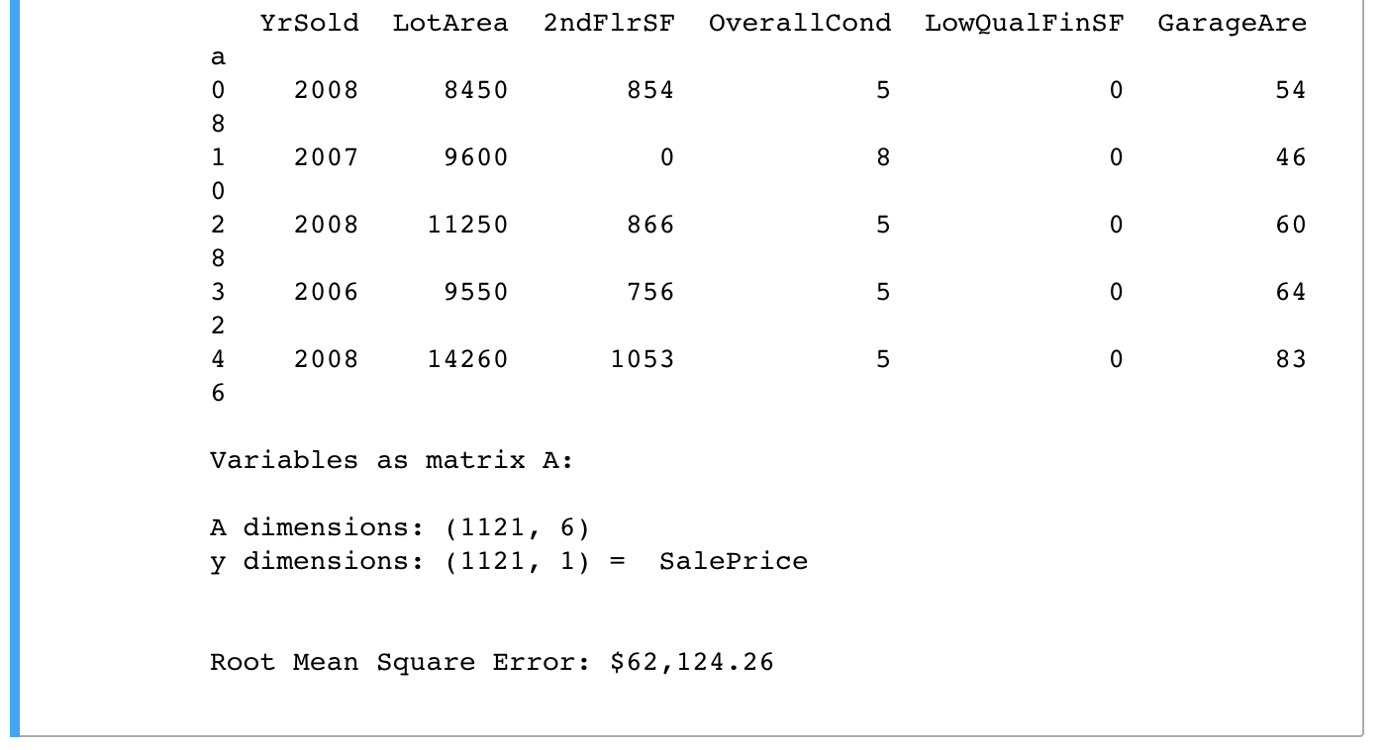
Smarter Method = Gridsearch
How about noncollinear features
RMSE = $62,124.26

Slide 20
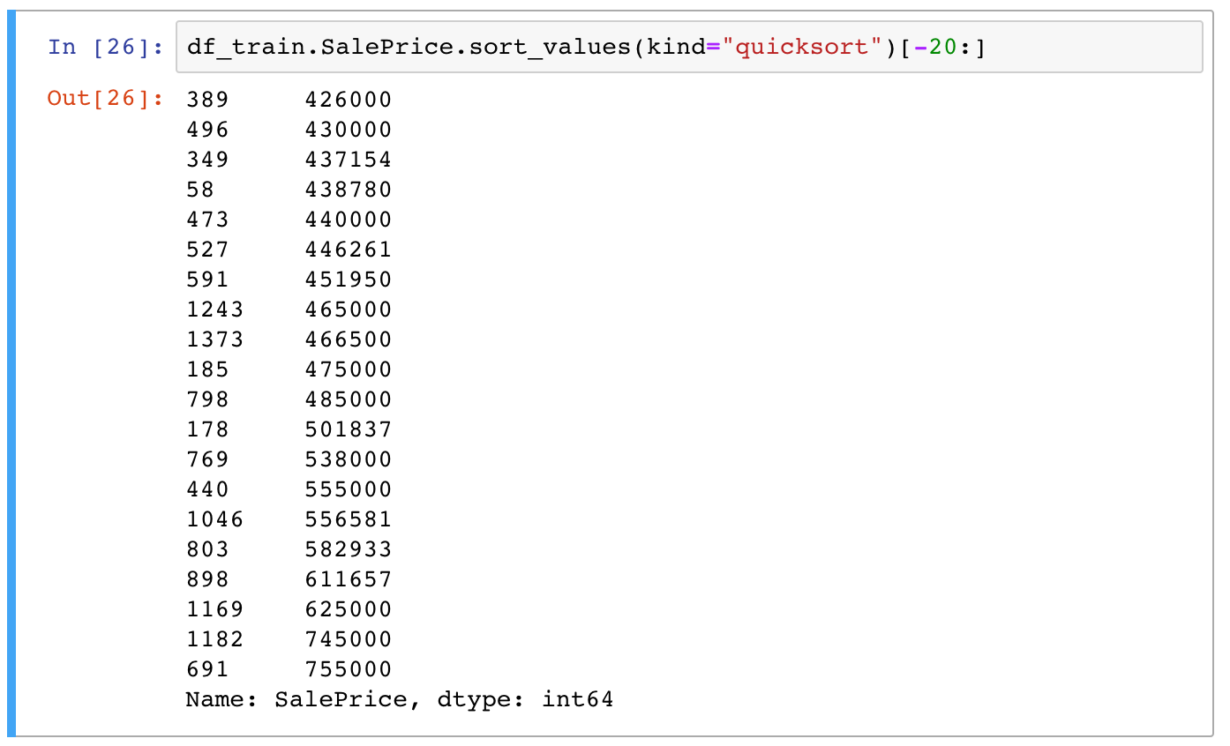
Dropping Outliers
Now that we have a few models, we go back to the data to look for any potential outliers

Slide 21
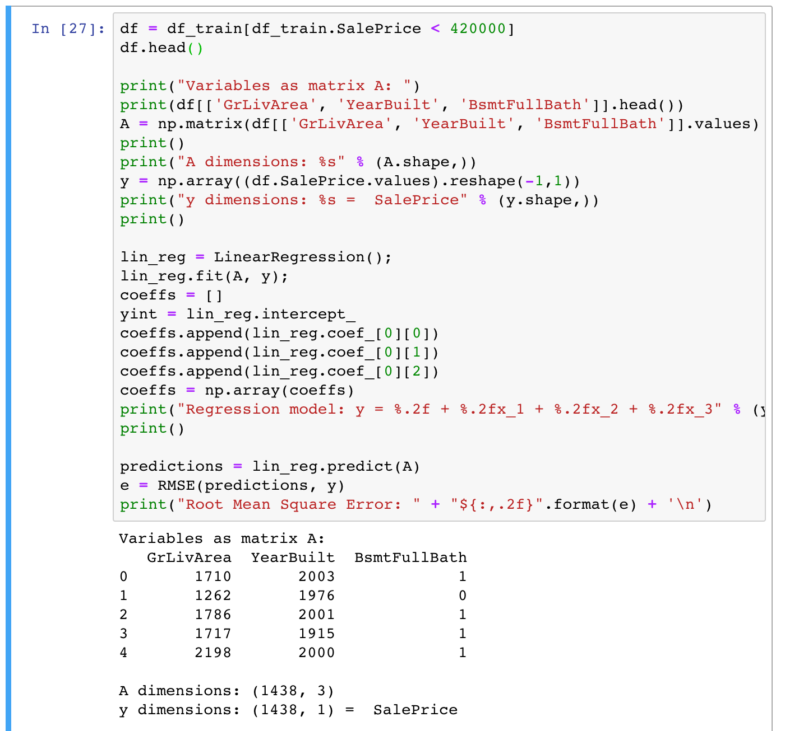
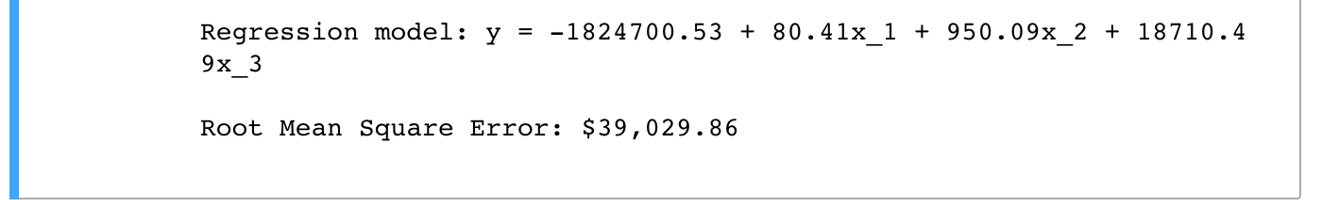
Dropping Outliers
Recalling our standard deviation for housing sale price was about $180 we drop any values greater than three standard deviations from the mean
Removing the outliers our RMSE drops to $39,029,86
Looking better, let’s try dropping anything greater than two standard deviations from the mean

Slide 22
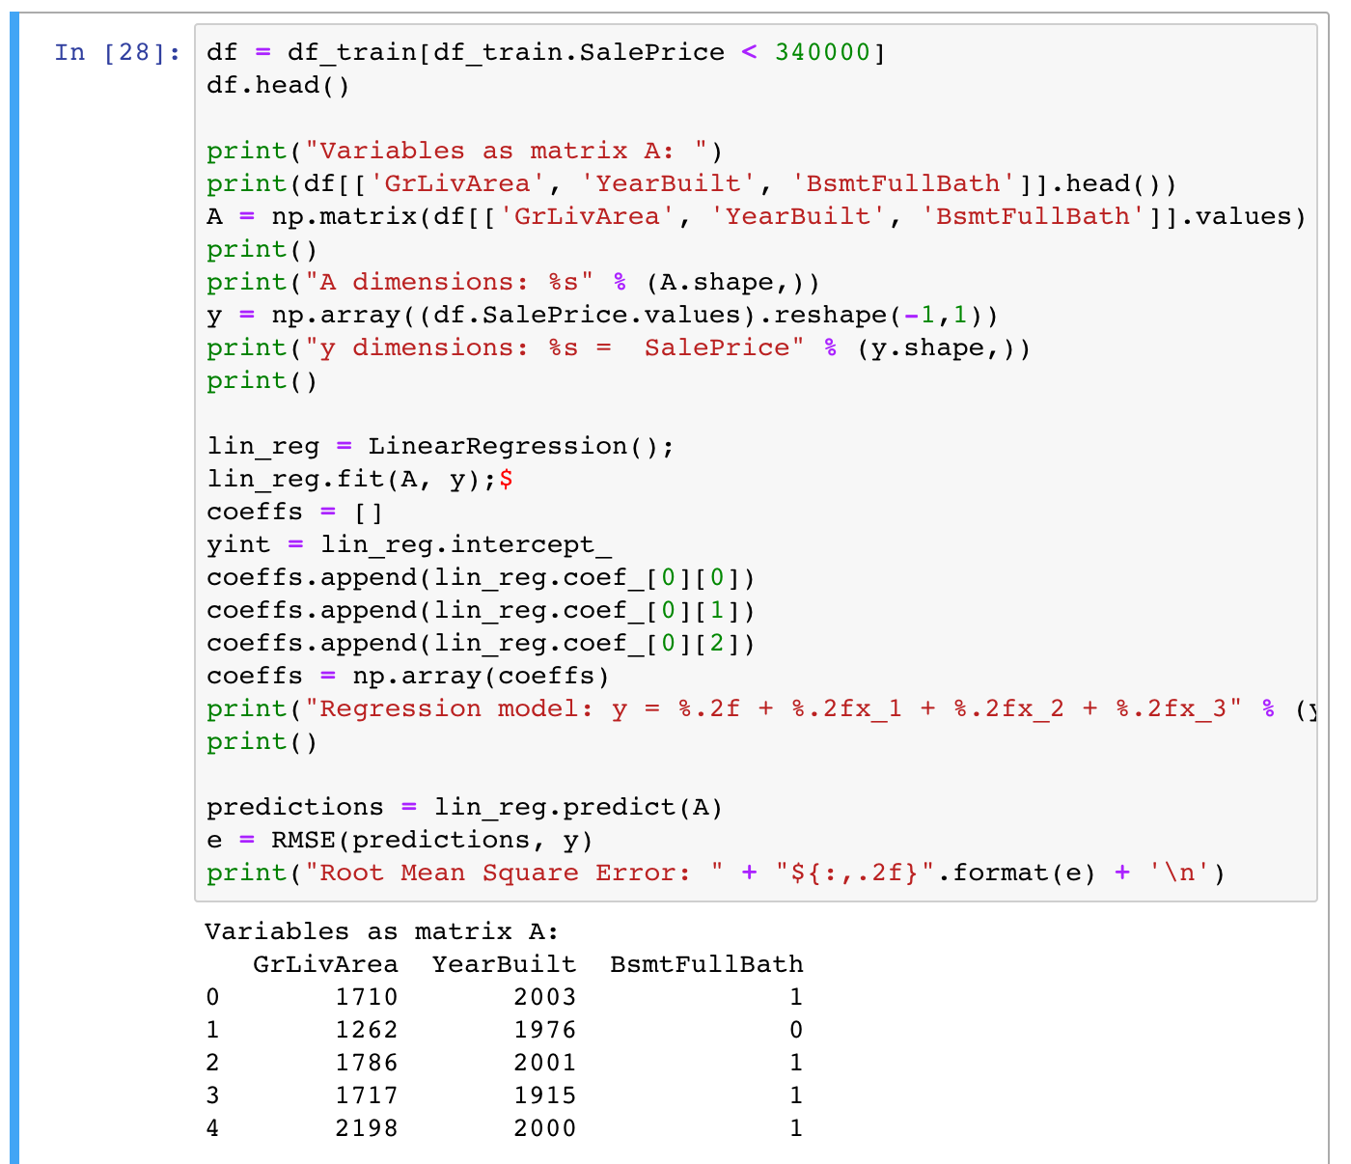
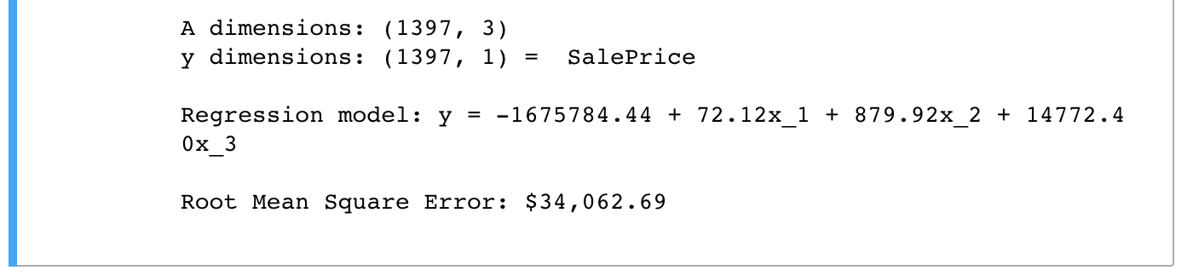
Dropping Outliers
Another improvement!
RMSE = $34,062.69
Let’s try a bunch removals

Slide 23
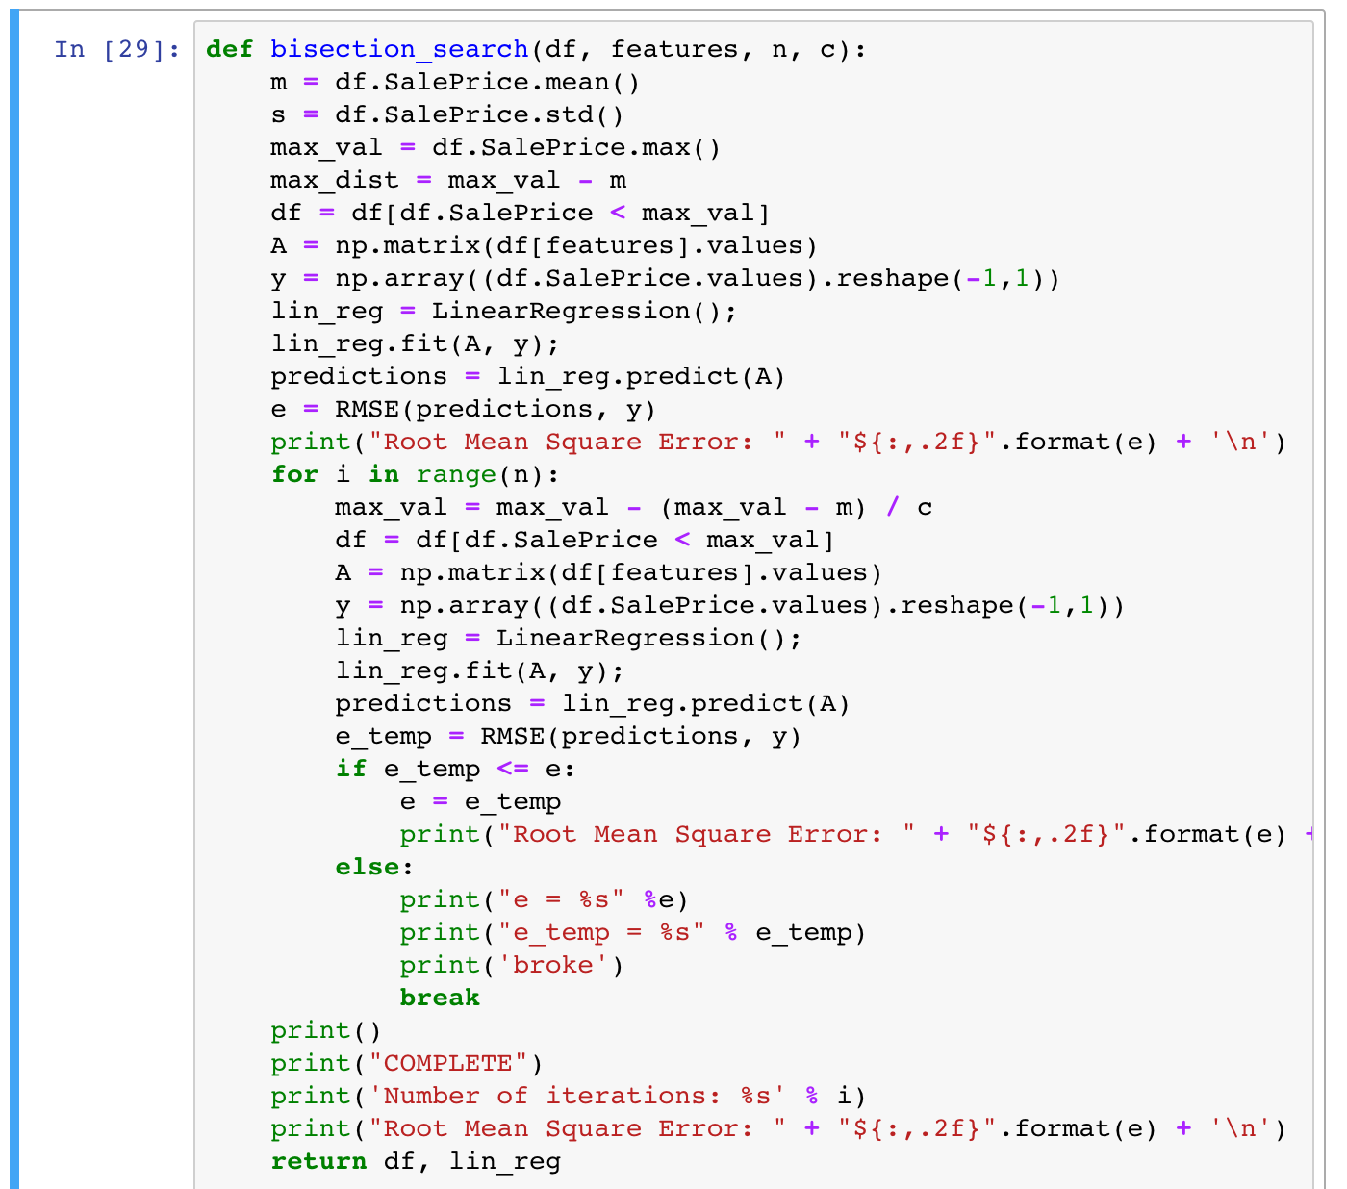
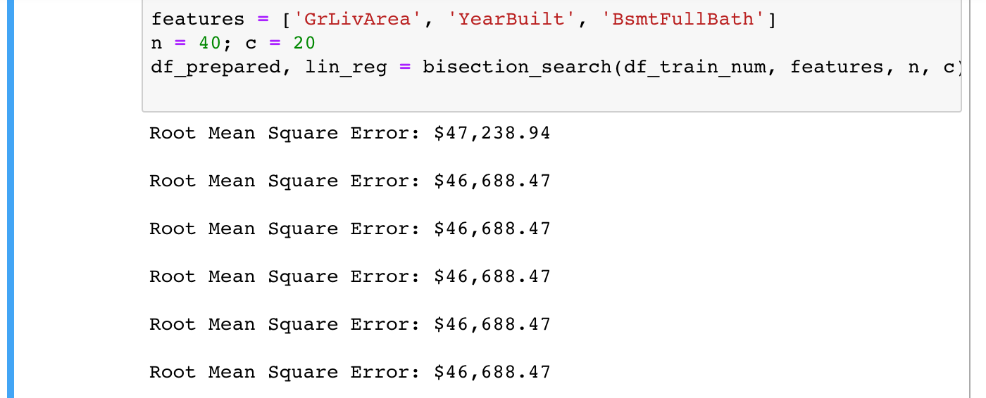
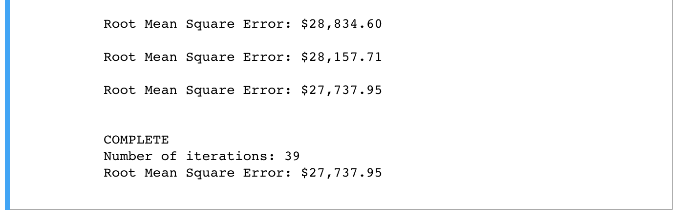
Dropping Outliers
After dialing the size, stopping short of overfitting, our tail
Reducing our RMSE to $27,737.95

Slide 24
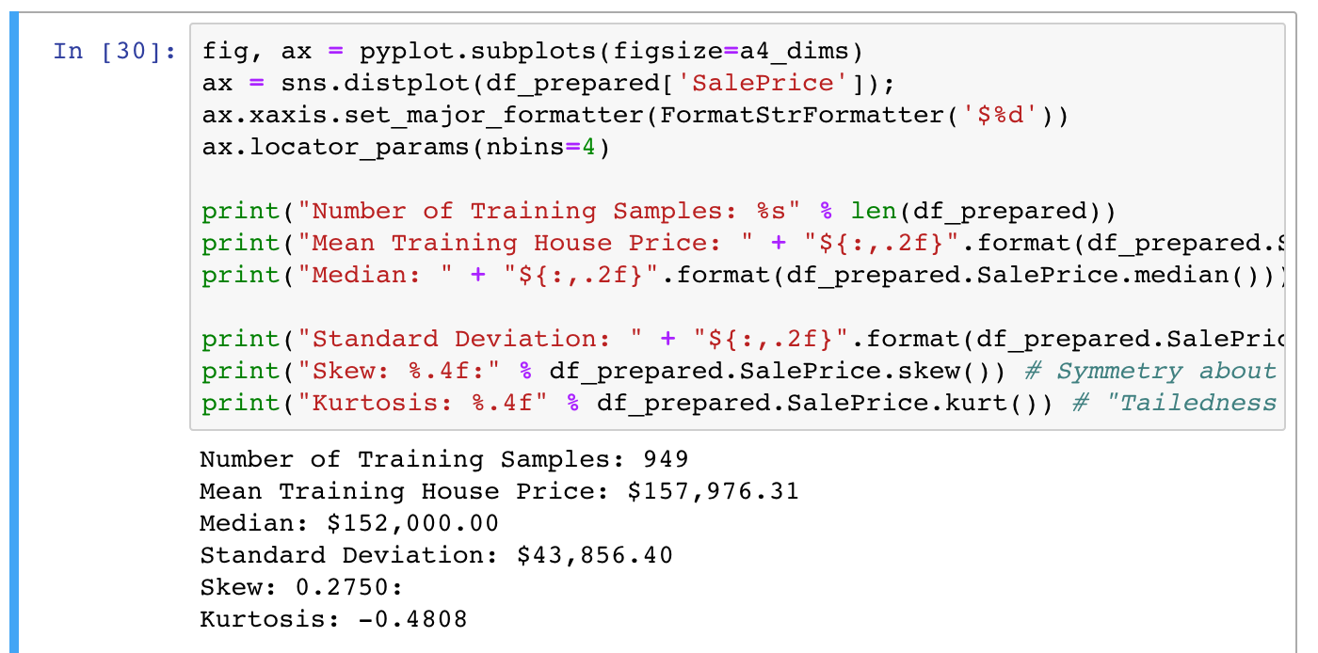
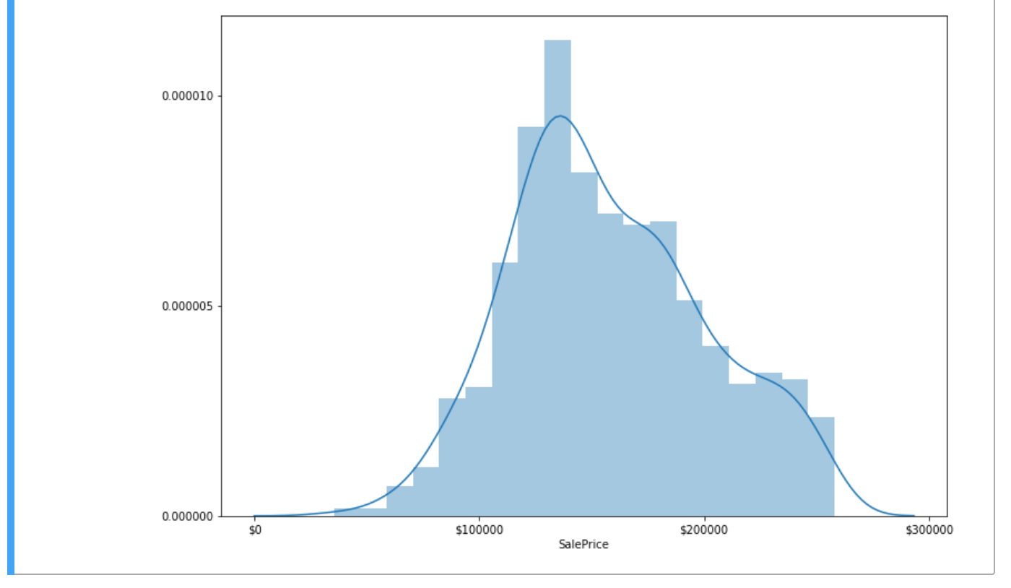
Dropping Outliers
Taking a look at our new SalePrice data
Distribution looks much more normal

Slide 25
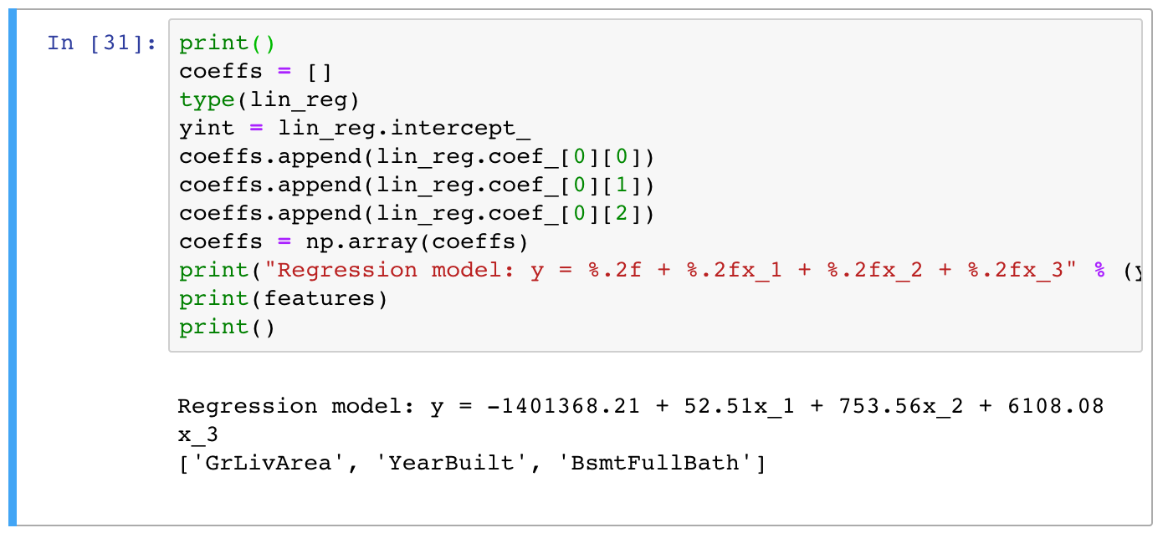
The Test
The previous function returned our current tuned model
Lets run it with our test data

Slide 26
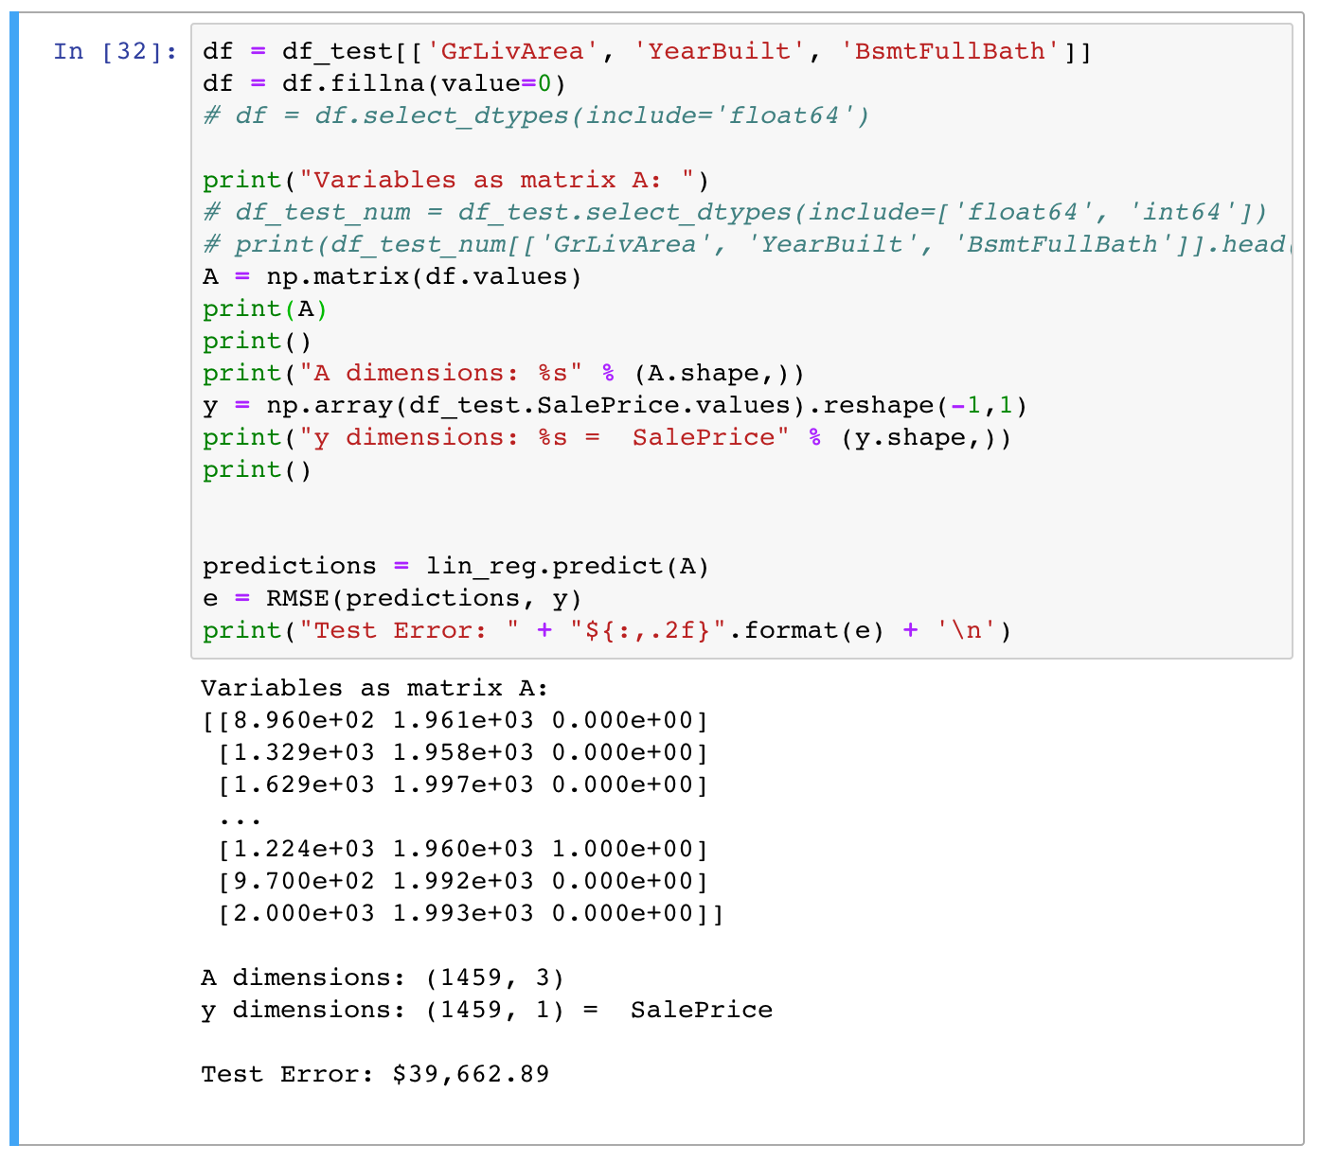
The Test
Our testing error, RMSE, is $39,662.89
A little high so let’s make our model even tighter

Slide 27
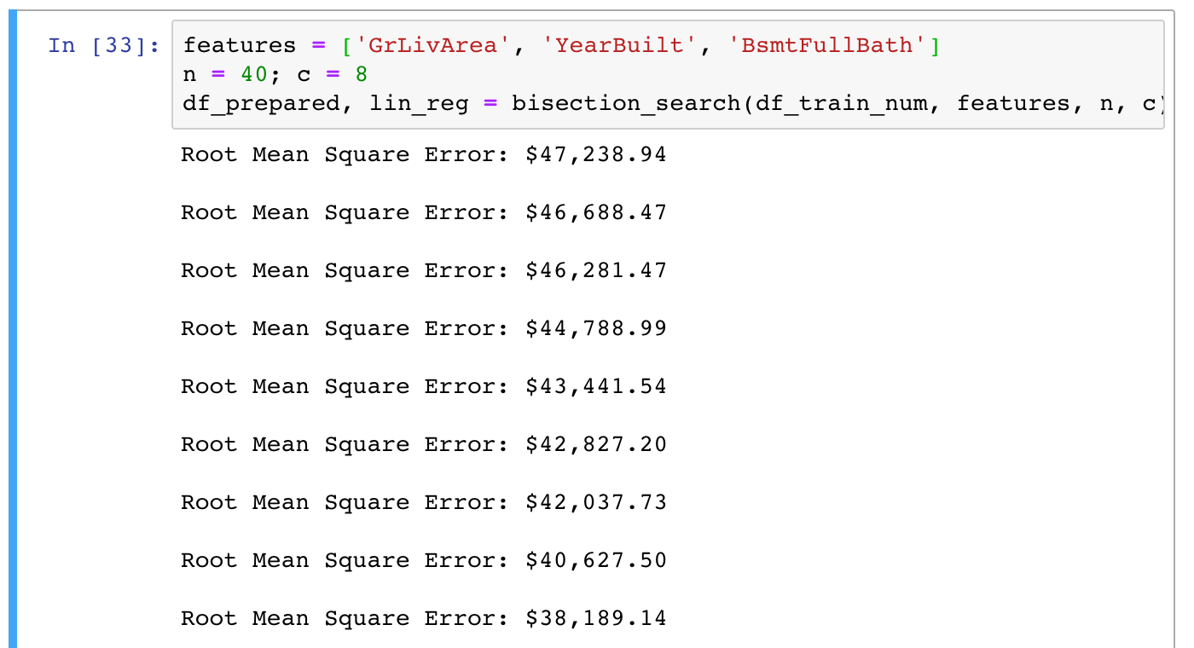
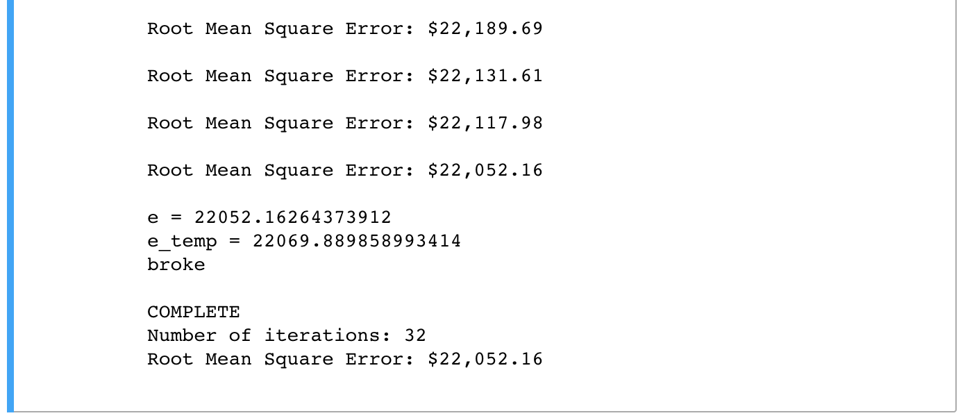
The Test
Tuning again using our training data
Reduces our training error to $22,052.16

Slide 28
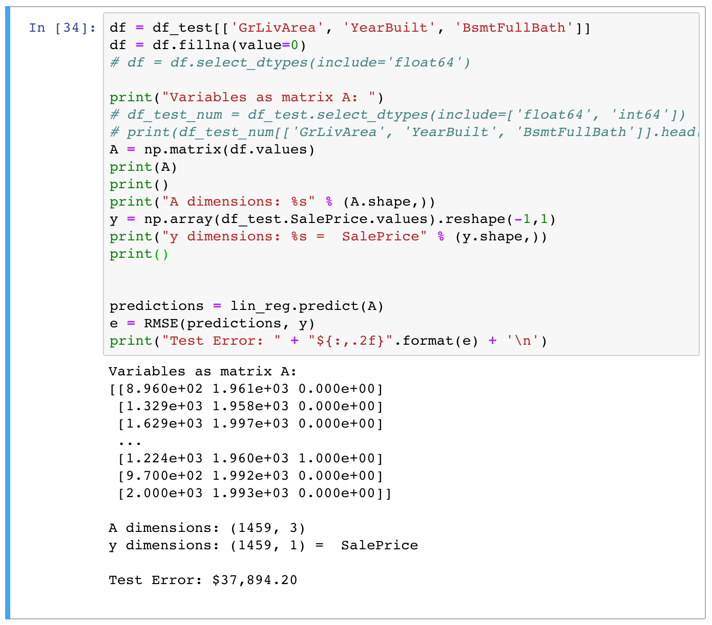
The Test
Applying our again reduced model to our test data we achieve an error of $37,894.20
In summary our renewed model is about twice as accurate as simple averaging
Removal of outliers improved sklearn’s linear regression by about 15%

Slide 29
References
Fuchs, Erin. “'Bankrupt' Rapper 50 Cent Has a 24-Bathroom House with a Nightclub in It.” Business Insider, Business Insider, 30 July 2015, www.businessinsider.com/curtis-50-cent-jackson-described-his- 24-bathroom-house-in-court-hearing-2015-7.
Géron, A. (2017). Hands-on machine learning with Scikit-Learn and TensorFlow: concepts, tools, and techniques to build intelligent systems. " O'Reilly Media, Inc.".

